Slide 1

Housing Market Analysis
Chicago Area
University of Illinois at Urbana-Champaign
IS590PRO Fall 2019 Final Project
Student: Joy Liang

Slide 2
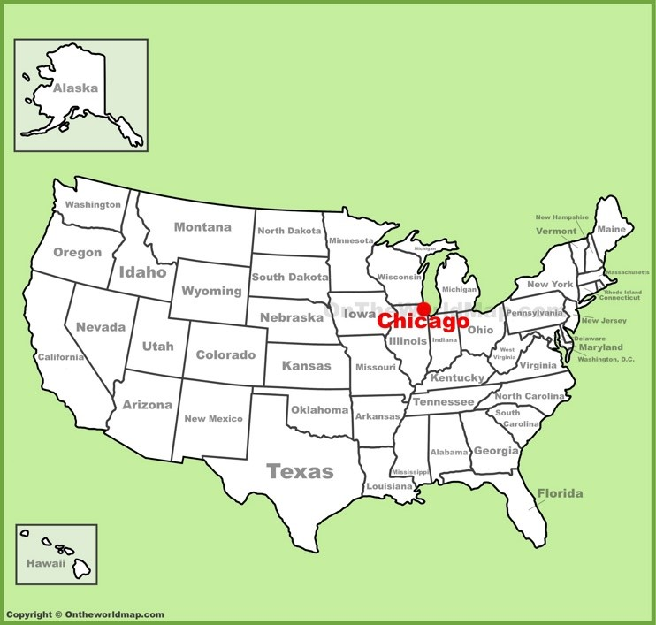
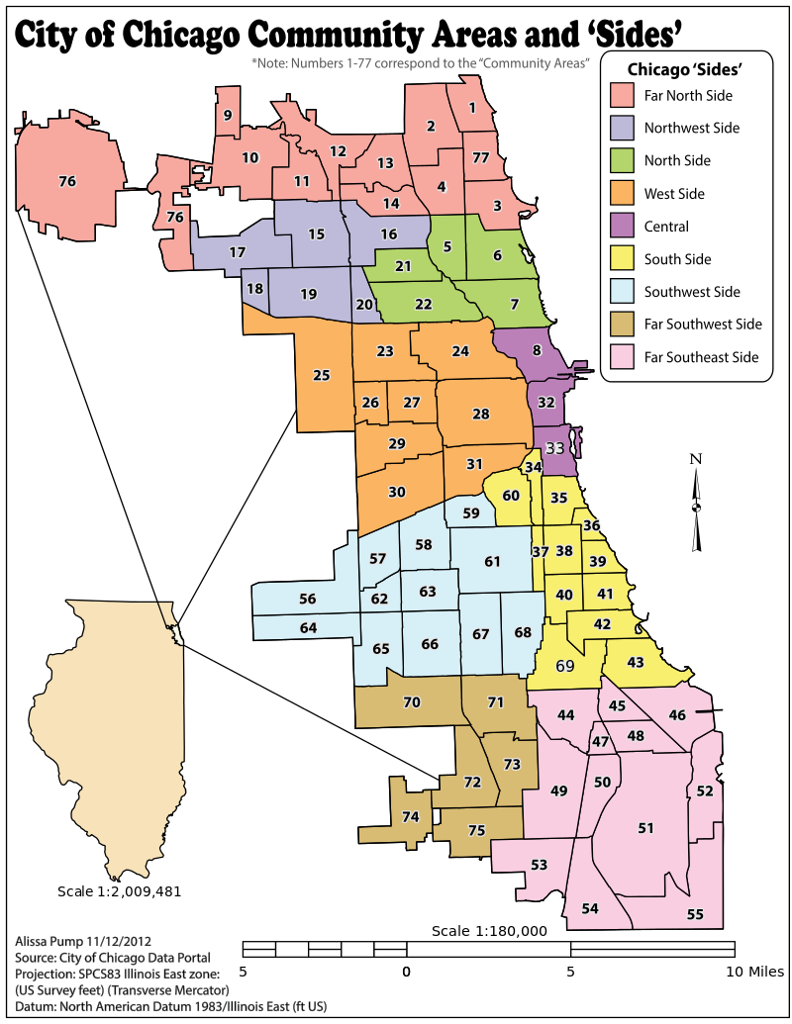
Summary
Chicago Area Description
The Greater Chicago Area is officially divided into 77 community areas (WIKIPEDIA). The 77 community belong to the below nine different sides:
Central
Far North Side
Far Southeast Side
Far Southwest Side
North Side
Northwest Side
South Side
Southwest Side
West Side
Tools and Resources:
Housing data is provided by Redfin, a national real estate brokerage.
30-year fixed mortgage rate is provided by Federal Reserve Bank of St. Louis

Slide 3
Hypotheses
Chicago house price is continually growing from 2012 to 2019
Median Sale Price Per Square Foot T or F?
The rise of Chicago housing market has slowed down
Median Sale Price Per Square Foot T or F?
Homes Sold T or F?
Mortgage rate has negative relationship with house price
T or F?

Slide 4
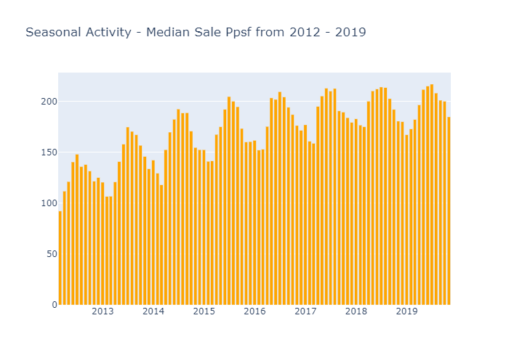
Hypotheses
Chicago house price is continually growing from 2012 to 2019
Median Sale Price Per Square Foot

Slide 5
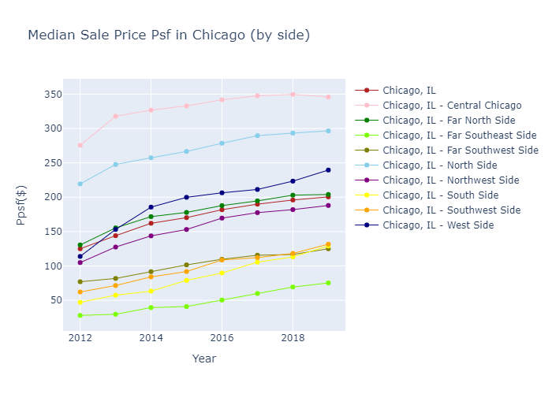
Hypotheses
Chicago house price is continually growing from 2012 to 2019
Median Sale Price Per Square Foot

Slide 6
Hypotheses
Chicago house price is continually growing from 2012 to 2019
Central Chicago
Near North Side
Loop
Near South Side
North Side
North Center
Lake View
Lincoln Park
Avondale
Logan Square
Which two sides are most expensive area?

Slide 7
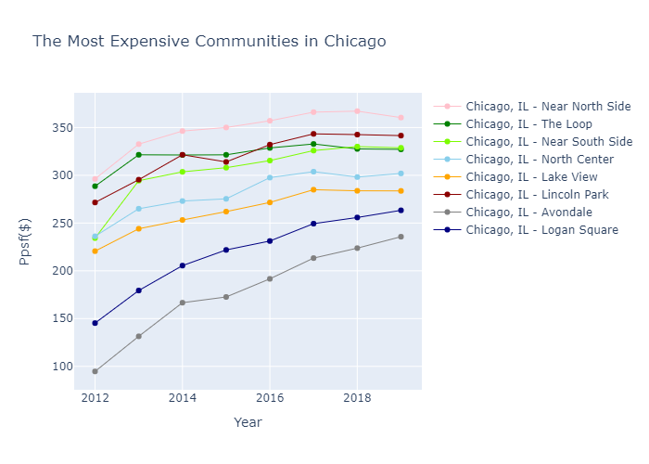
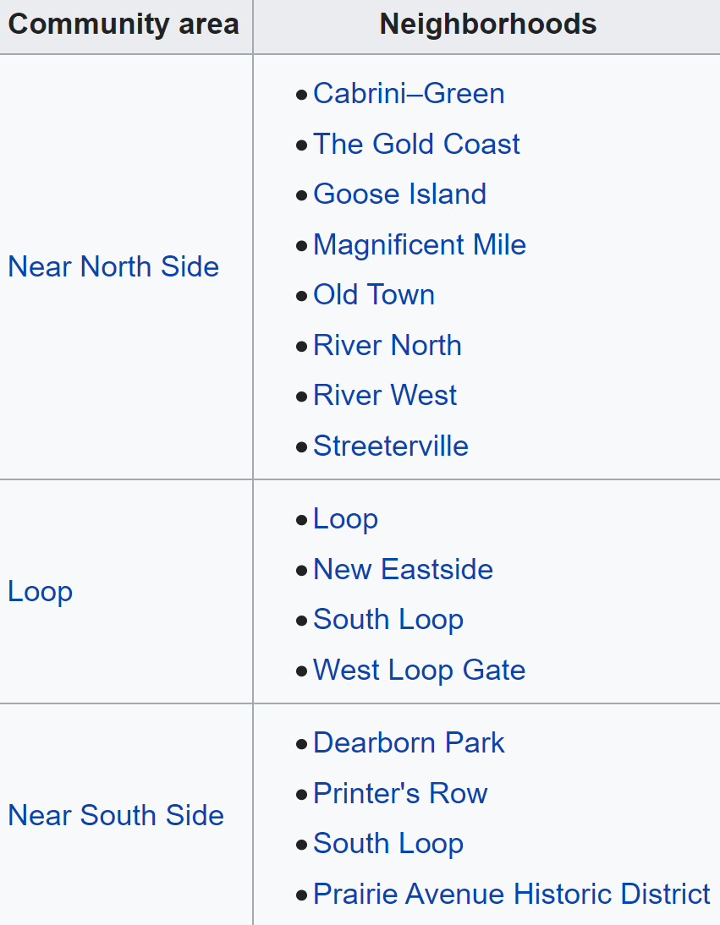
Hypotheses
Chicago house price is continually growing from 2012 to 2019

Slide 8
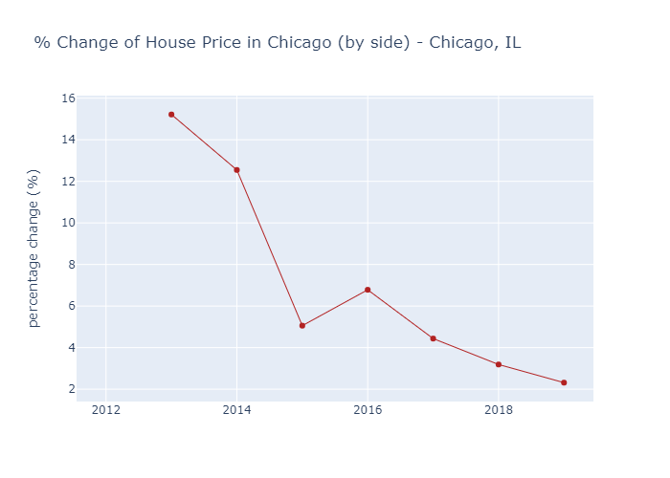
Hypotheses
The rise of Chicago housing market has slowed down
Median Sale Price Per Square Foot
Percentage change from 2012 - 2019:
2013: There was a 15.22% median sale price per square feet increase in 2013 compared to 2012.
2014: There was a 12.55% median sale price per square feet increase in 2014 compared to 2013.
2015: There was a 5.06% median sale price per square feet increase in 2015 compared to 2014.
2016: There was a 6.78% median sale price per square feet increase in 2016 compared to 2015.
2017: There was a 4.44% median sale price per square feet increase in 2017 compared to 2016.
2018: There was a 3.19% median sale price per square feet increase in 2018 compared to 2017.
2019: There was a 2.32% median sale price per square feet increase in 2019 compared to 2018.

Slide 9

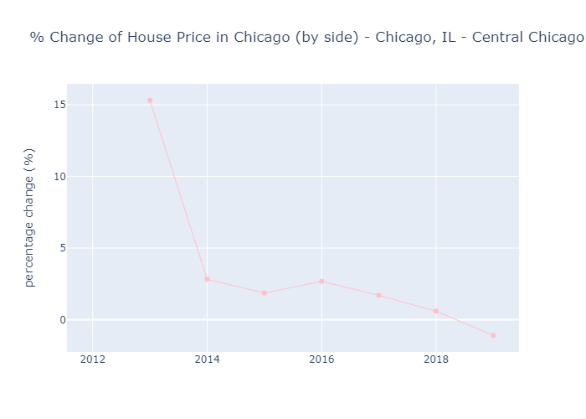
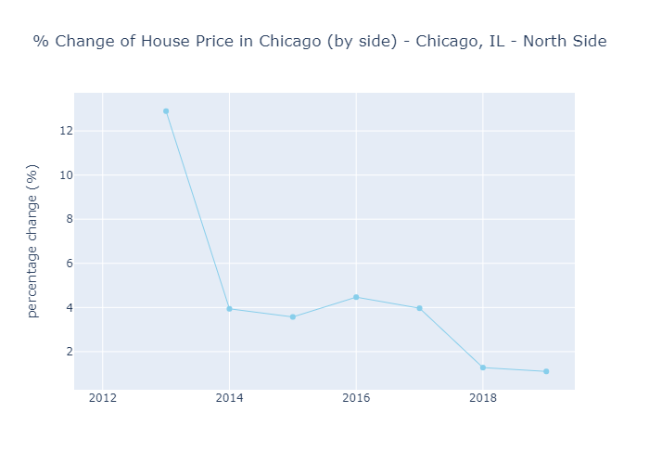
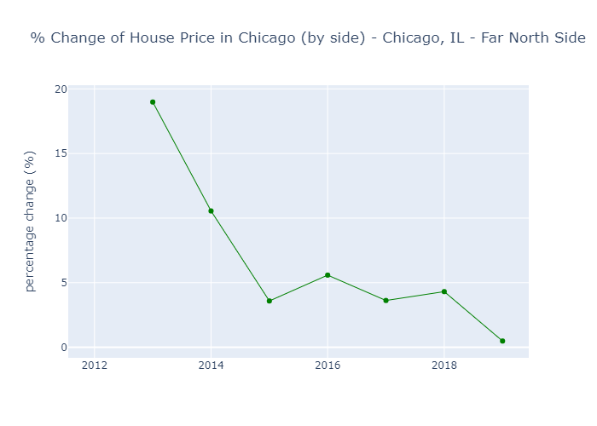
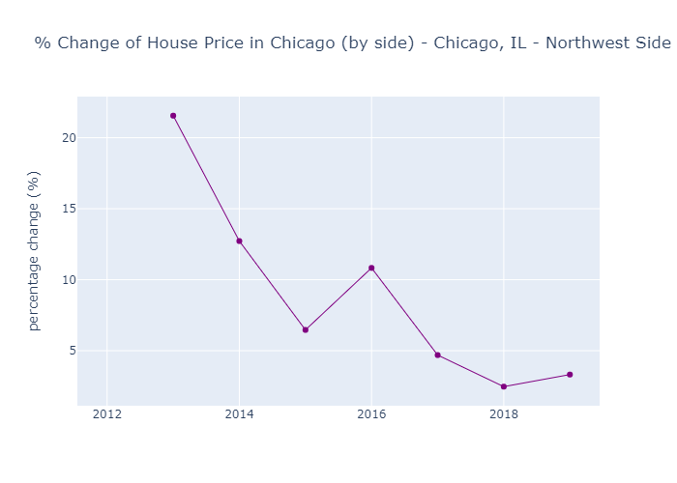
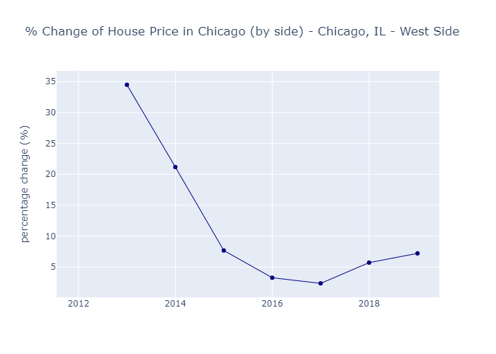
Hypotheses
The rise of Chicago housing price has slow down
Median Sale Price Per Square Foot
Yes
If the house price of other areas have also slow down ?

Slide 10
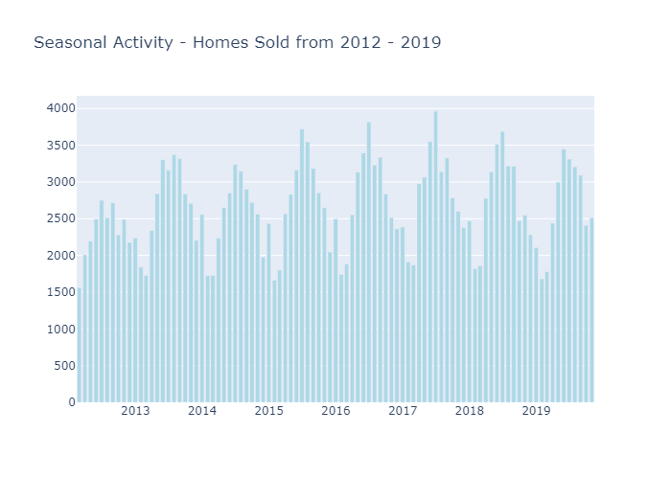
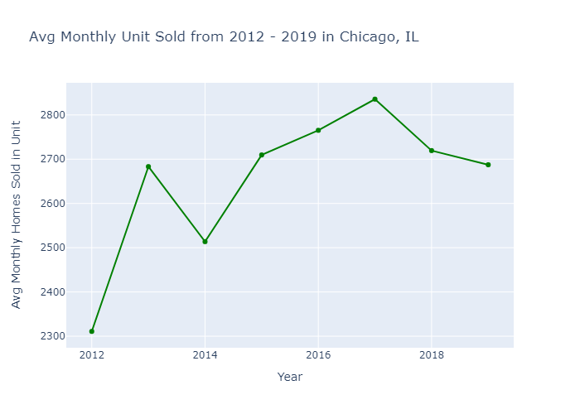
Hypotheses
The rise of Chicago housing price has slow down
True
Homes Sold

Slide 11
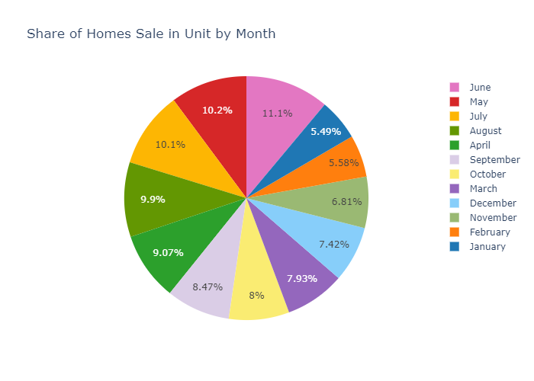
Hypotheses
The rise of Chicago housing price has slow down
Homes Sold
Is there a particular month where houses are sold more?
List in the spring
Sell in the summer
Weather drives when sales peak

Slide 12
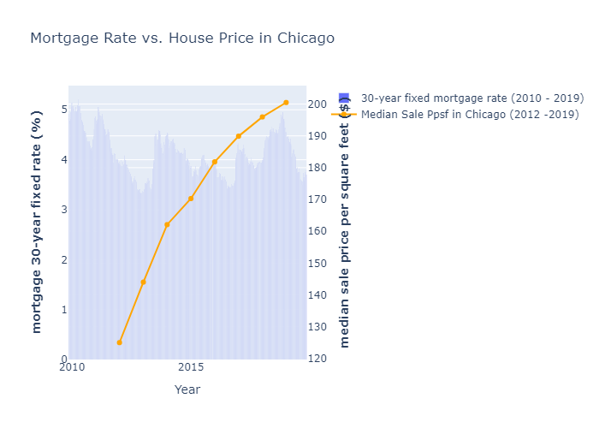
Hypotheses
Mortgage rate has negative relationship with house price
Do rising mortgage rates trigger lower house prices?

Slide 13
Conclusions
Chicago house price is continually growing from 2012 to 2019
Median Sale Price Per Square Foot is still increasing
The rise of Chicago housing market has slowed down Truth
The rise of Median Sale Price Per Square Foot has decreased
The units of Home sold has decreased
Mortgage rate has negative relationship with house price False
No direct relationship with house price
Truth

